Slide 1
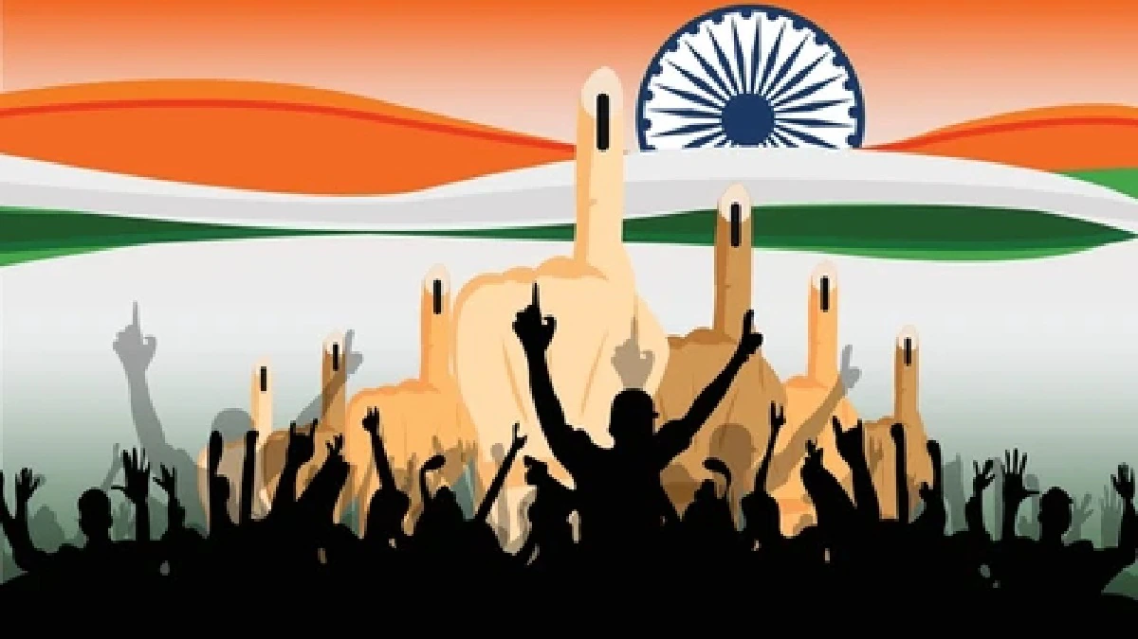
INDIAN ELECTION ANALYSIS
TEAM-B
GUDA ANURAG PRATEEK ABHINAV BHUTRA DEEPIKA GAURAV

Slide 2
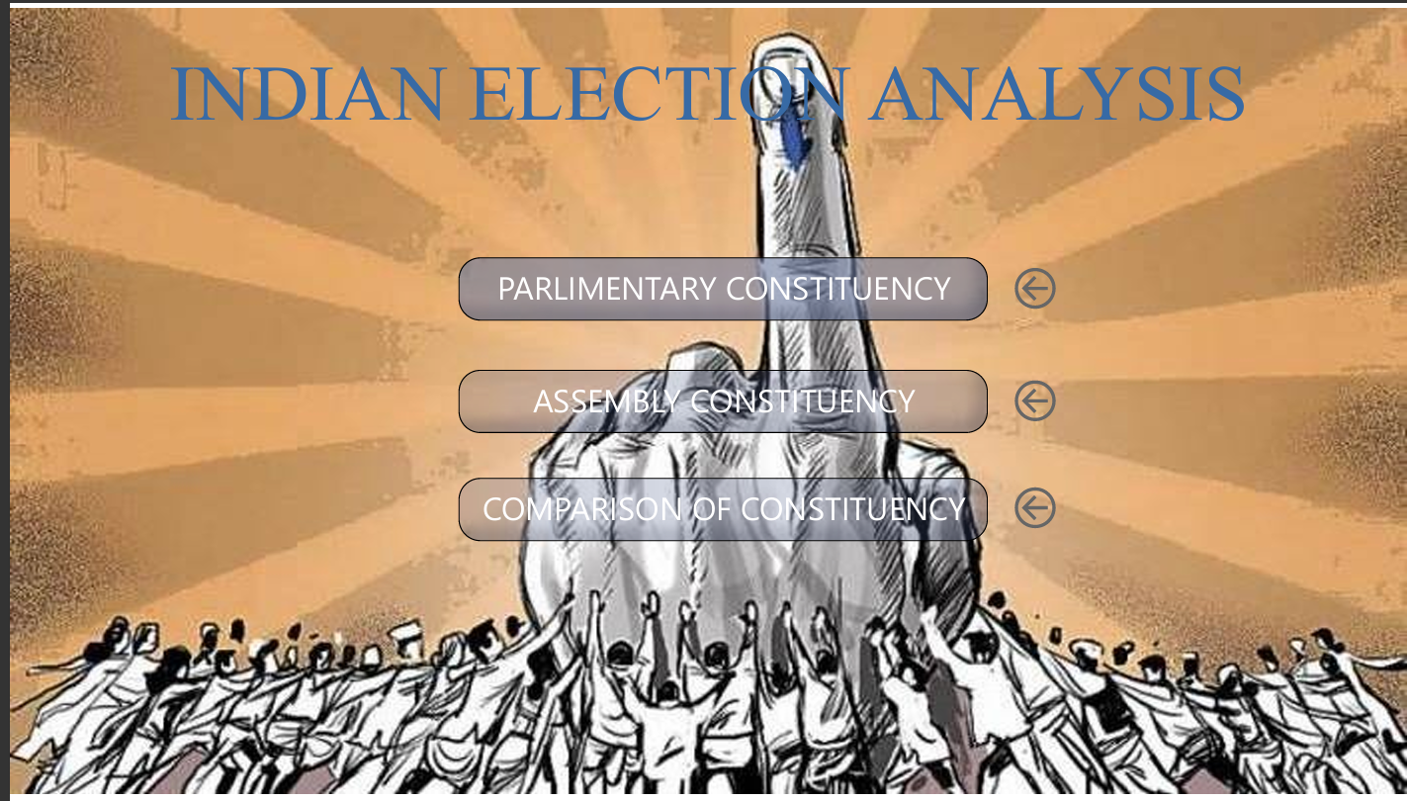
Abstract
Elections play a crucial role in a democratic country like India, as they allow citizens to choose their representatives. However, election data is complex and difficult to understand in raw format. This project uses Power BI to visualize Indian election data clearly and effectively. Through charts and dashboards, the project provides insights into party performance, vote distribution, gender participation, and constituency-wise analysis, making election results easy to interpret for both the public and political parties.

Slide 3
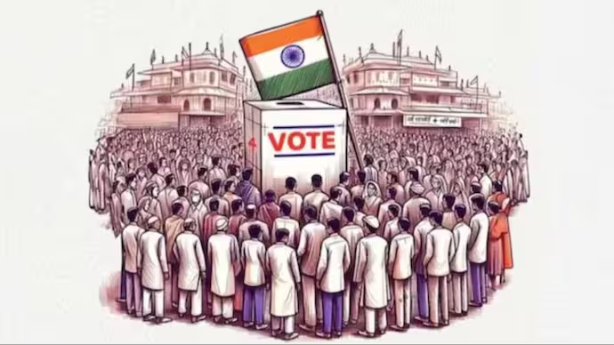
Introduction
India follows a democratic parliamentary system where elections are conducted at both national and state levels. Parliamentary elections elect Members of Parliament, while Assembly elections elect Members of the State Legislative Assembly. Understanding election results is important to analyze political trends, voter behavior, and party dominance. This project aims to study Indian elections through data analysis and visualization techniques.

Slide 4

Project Overview
This project focuses on analyzing Indian Parliamentary and Assembly election data using Power BI. The main aim is to transform complex and large election datasets into interactive and easy-to-understand dashboards. The analysis highlights voting patterns, party performance, candidate trends, and gender participation across different states and years. By using effective visualizations, the project helps users gain clear insights and supports better understanding of election outcomes.

Slide 5

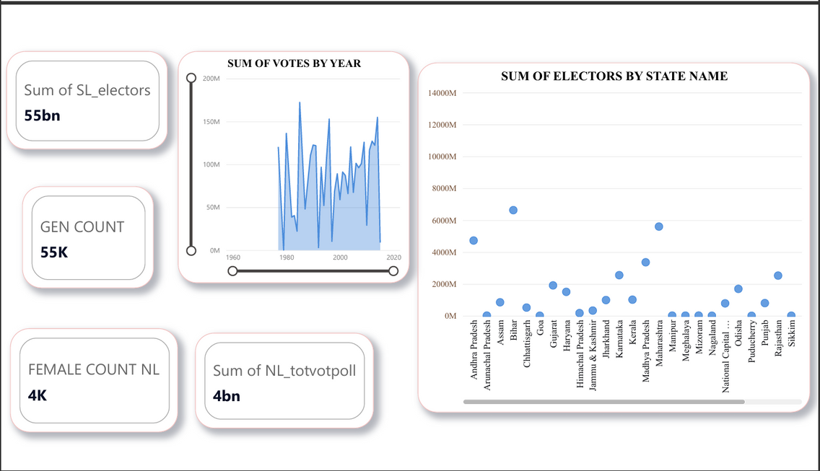
Data Collection & Tools and Technologies
The data used in this project was obtained from an open-source Kaggle repository. It includes detailed information on candidates, parties, constituencies, votes received, and registered electors. The dataset spans multiple election years, enabling long-term trend analysis.
Power BI is used as the primary analytical and visualization tool. Power Query assists in data preparation, while DAX is applied to create calculated measures and columns. These tools together enable efficient data modeling and interactive dashboard creation

Slide 6
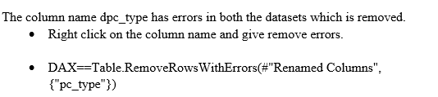
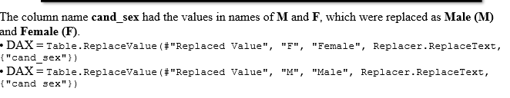
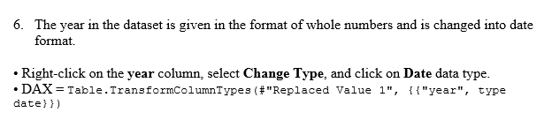
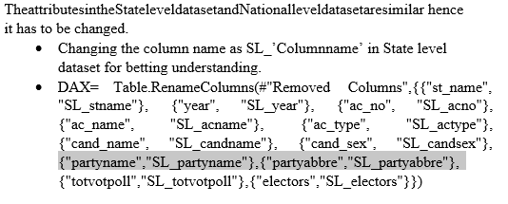
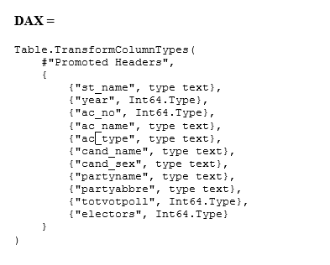
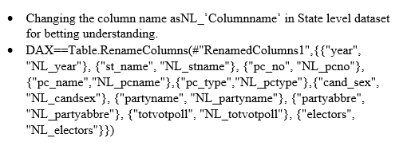
Formulas used

Slide 7
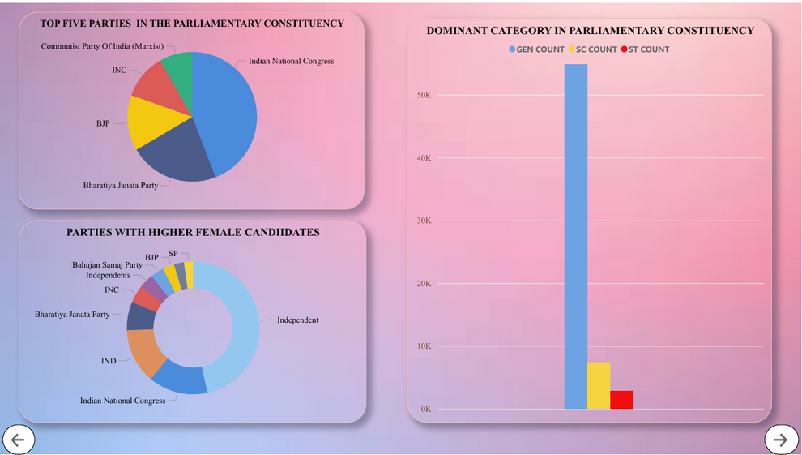
Data Cleaning &Data Transformation and Modeling
To ensure accuracy, the dataset was cleaned by removing inconsistencies and errors. Gender values were standardized, column names were modified for clarity, and invalid entries were eliminated. Proper data cleaning improved reliability and ensured meaningful analysis.
Data transformation involved filtering, renaming, and restructuring columns using Power Query. A star schema data model was designed to establish relationships between tables. This modeling approach enhances performance and simplifies analytical reporting in Power B

Slide 8
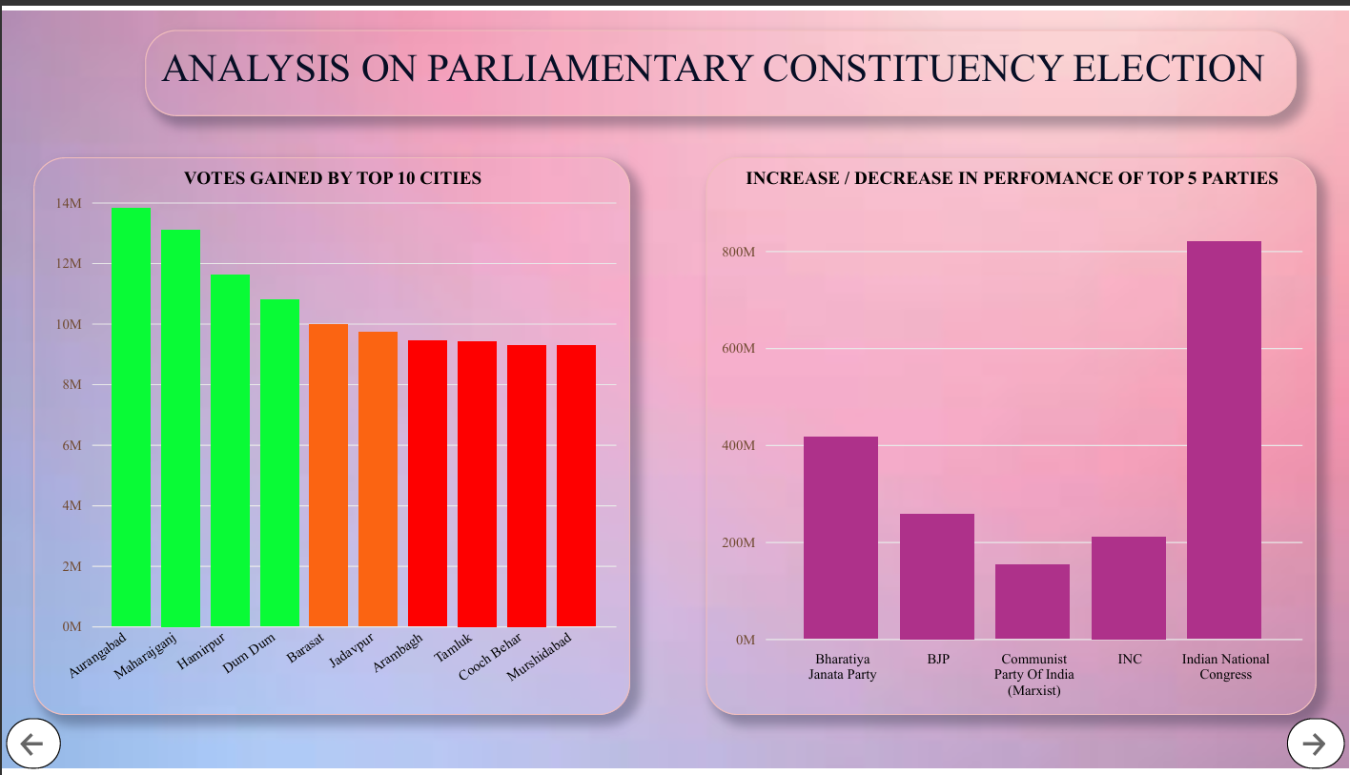
Parliamentary Constituency Analysis
This section analyzes Parliamentary election data to identify dominant political parties, leading cities, and reservation category trends. It also evaluates changes in party performance over time and highlights female participation in national elections.

Slide 9
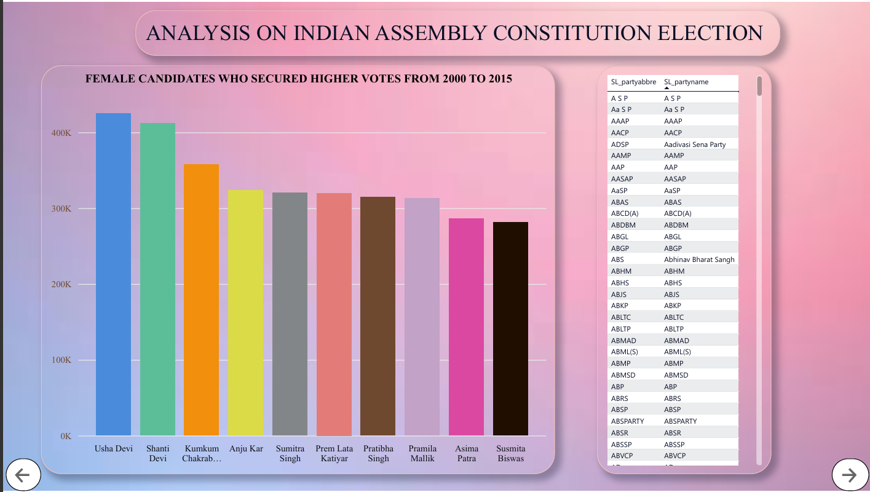
Assembly Constituency Analysis
Assembly election analysis focuses on state-level trends. It identifies top-performing candidates, major vote-securing states, and gender-wise vote distribution. Special attention is given to candidates from Tamil Nadu who consistently performed well across years.

Slide 10
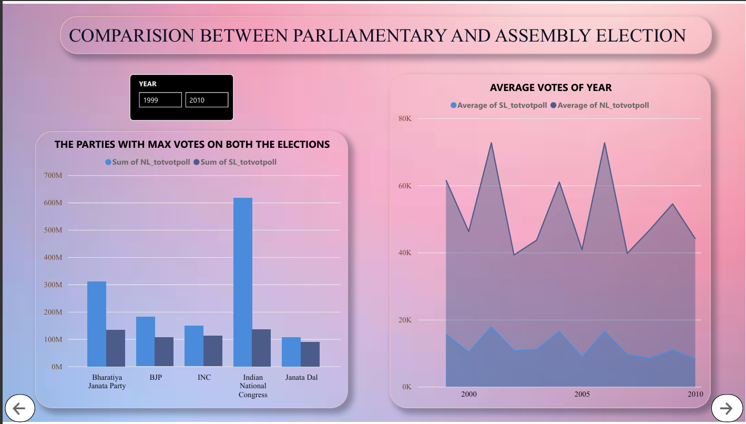
Comparative Election Analysis
A comparative study between Parliamentary and Assembly elections was conducted to evaluate differences in voting patterns. Party dominance, average votes per year, and total votes were compared to understand how voter behavior varies across election types.

Slide 11
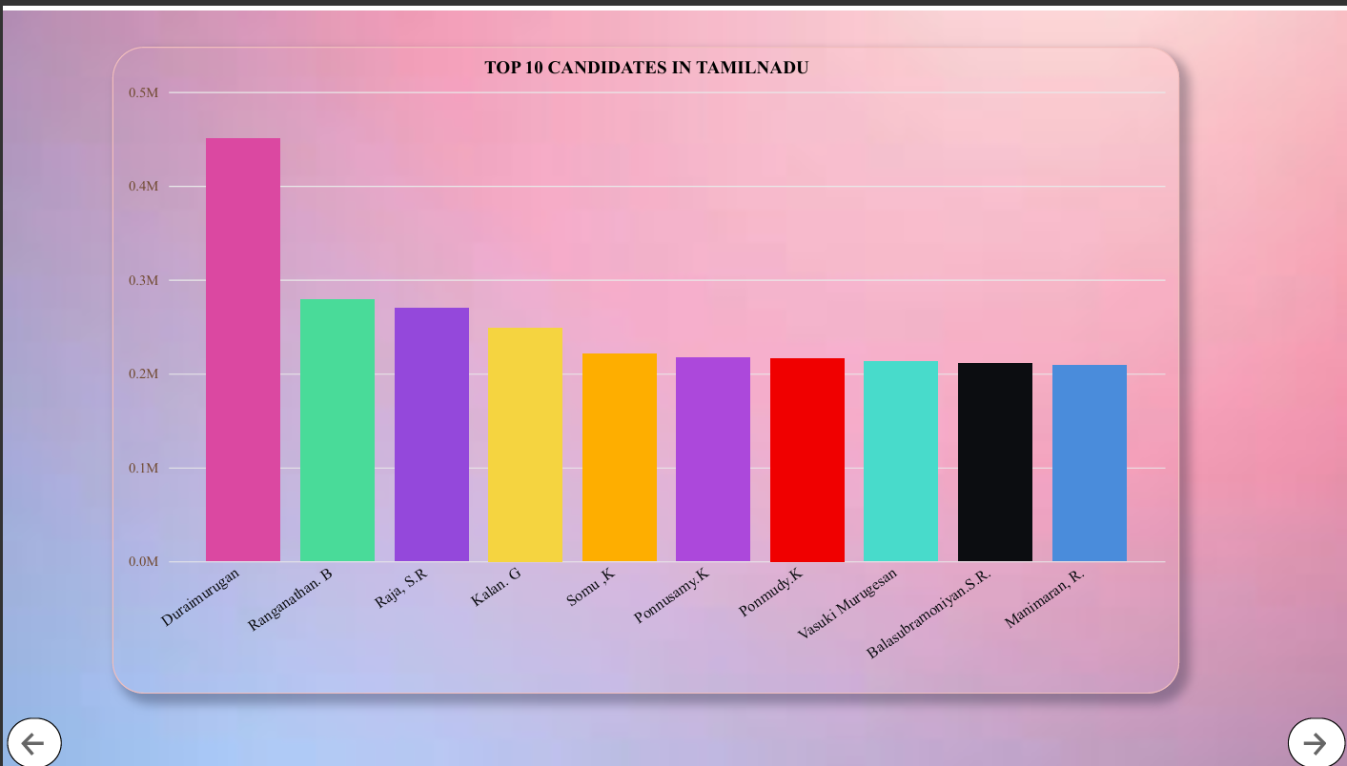
Conclusion
This project successfully demonstrates how Power BI can be used to analyze and visualize Indian election data in an effective manner. The interactive dashboards provide clear insights into party performance, voting trends, gender participation, and constituency-wise results. By converting complex datasets into visual reports, the analysis helps political parties, candidates, and citizens understand election outcomes easily. Overall, the project proves that data visualization plays a vital role in simplifying large-scale election data.

Slide 12
THANK YOU
TEAM-B
Submitted by
GUDA ANURAG PRATEEK
ABHINAV BHUTRA
DEEPIKA
GAURAV

